Slide 1
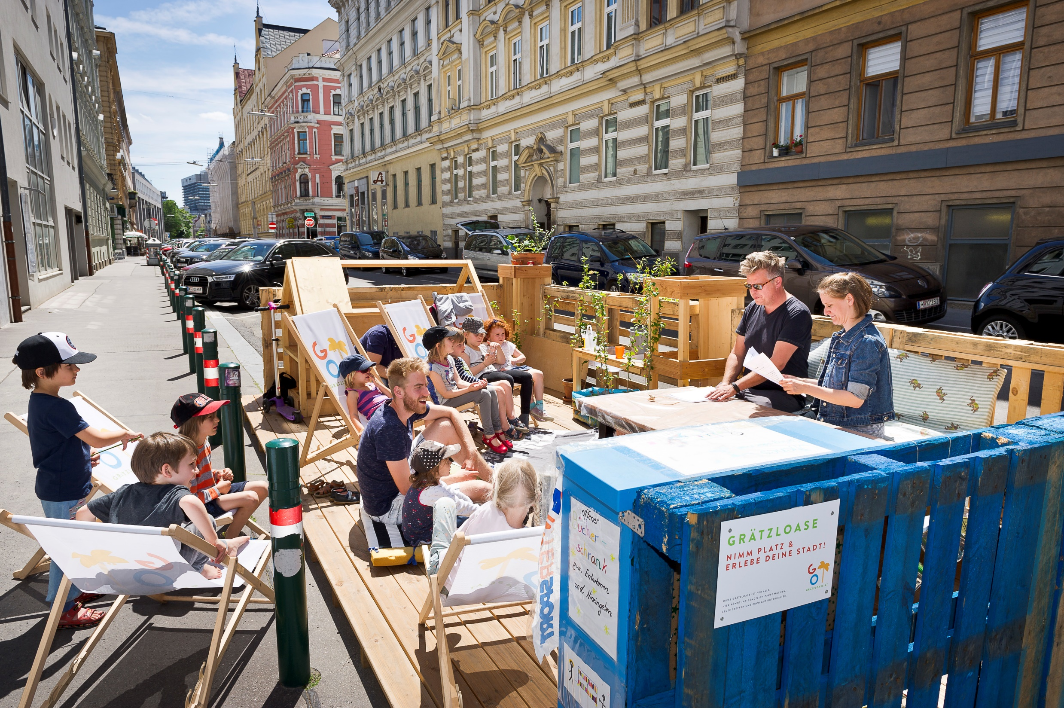



Local Agenda 21 in Vienna
Participation for a sustainable district development
Andrea Binder-Zehetner
©Daniel Dutkowski

Slide 2

Local Agenda 21 participation framework – embeddedness into policy making process
Target: Involve all citizens in the sustainable development of their district, early participation: from the idea to implementation
Area of Action: District level = living environment of the citizens
Support structur: Agenda offices at the district level & association LA21Vienna: coordination, link to city level
Medium-term duration: 4 to 6 years
Base: political descisions of city council and district council
Financiation: city and district share the costs of the support structur, 50 %:50% , district pays the projects

Slide 3
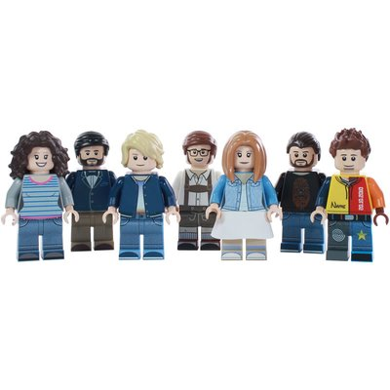

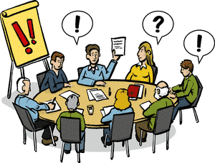
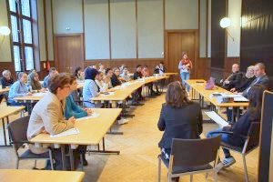





Ideas
Ideas
District Counsellor, district deputies
District Comission
District Council
Citizens
Project proposal
Project
Develop-ment
STGr.
Citizens = spokesperson for the projects
Agenda Office Support: Communication design, facilitation, Mediation, organisational support, expert knowledge, public relations work
Decision: What becomes a project?
Counselling
Recommendations
Consent principle
Presentation of interim results
Decision
Embeddedness into district policy making

Slide 4
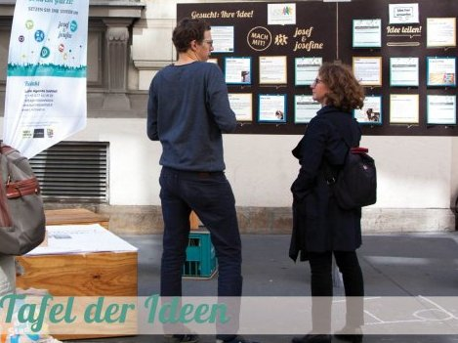
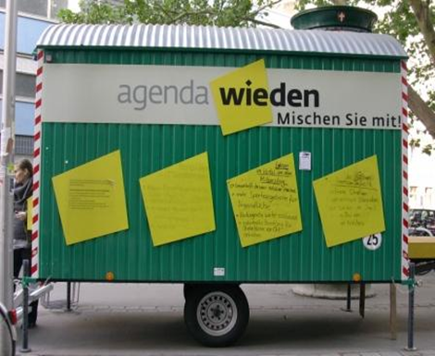
How to target the public?
Analysis of the institutional network in the district
eye –catching action in the public space,
Interviews, out reaching work in parks, streets and on
places
Random selection of citizens for citizens councils
Ideas competition with a little prize money
Combination of on the spot action with online
participation
Low treshold action like walks, community cooking
Charette: open planning office on site

Slide 5
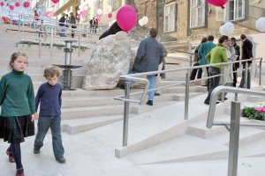
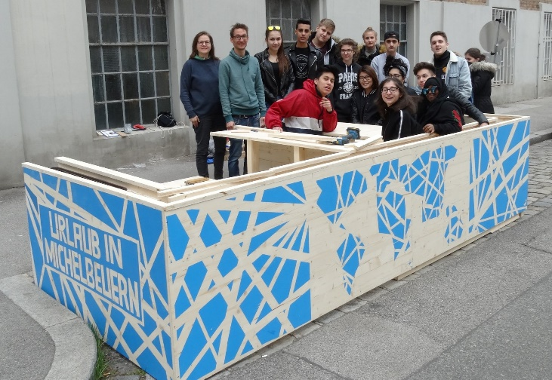
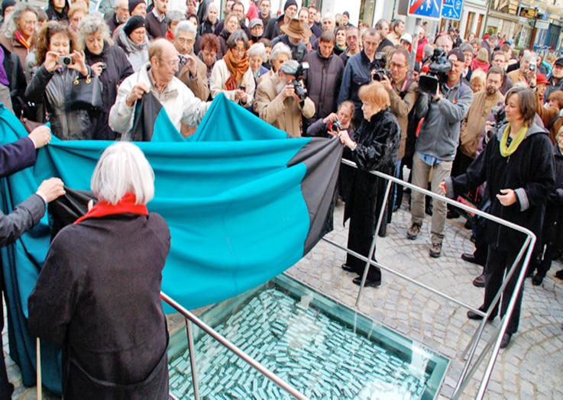
Topics & Projects Alsergrund
Public Space: Barrier-free stairs: Thurnstiege /Redesign Berta Löwi Weg (footpath): more attractive, more plants, raised beds/Redesign Alserbach street: new trees, enlargement of the pavement, new benches, chairs/Parklet „Holiday in Michelbeuern“/Map of quite places in the district, measures of noise reduction /Skaterpark /
Mobility: first idea for a rental bike system
Climate change adaption: Citizen council to collect ideas
Generation Dialog: Readings, Video, Exhibitions
Integration: Language Café to practise german
Fair Trade: Shopping guide
Commemoration of the expulsion of Jews : Installation of different commemoration symbols

Slide 6

Thank you for your attention !
Verein Lokale Agenda 21 in Wien
Grüngasse 9/5, A-1050 Wien
T +43 1 5858040-10
F +43 1 5858040-13
office@la21wien.at
www.la21wien.at

